Slide 1
PowerTeacher Gradebook PTG and PowerTeacher Pro PT Pro A Comparison
The following slides will give you an overview of the changes that will occur moving from PowerTeacher Gradebook to PowerTeacher Pro. The top items are covered here. For a complete details please consult the Powerteacher Pro User Guide available on DataConnect (www.dataconnect.nbed.nb.ca)

Slide 2
PowerTeacher Gradebook Has Been Improved…

Slide 3
…With PowerTeacher Pro
Please review the next few slides to show you the top features compared from Gradebook to PowerTeacher Pro.

Slide 4
Key PowerTeacher Pro Features
Easy and Fast Web Based Access
New easy to use and interactive design
Assignments can now be created and assigned for individual students
Ease of access to all assignments
Student roster reports easily customizable with additional information
Easy to use keypad for grade entry
New and easy to use score flags for “Absent” or “Incomplete”
Graphic analysis of grades with coloured visuals

Slide 5
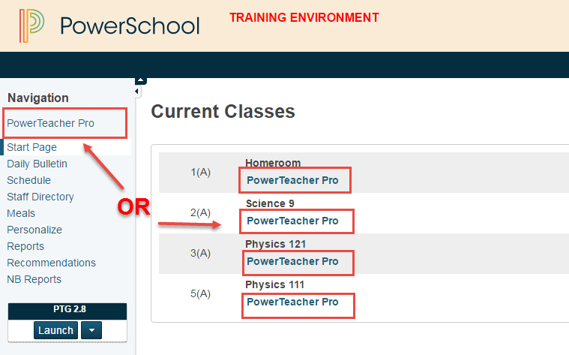
Launching PowerTeacher Pro is easy…
NEW to PowerTeacher Pro is the seamless integration with PowerTeacher so your gradebook opens in seconds.
Gone are the need for a second Java Gradebook application being launched.
PT Gradebook is still available for your reference to previous years data in Read Only

Slide 6
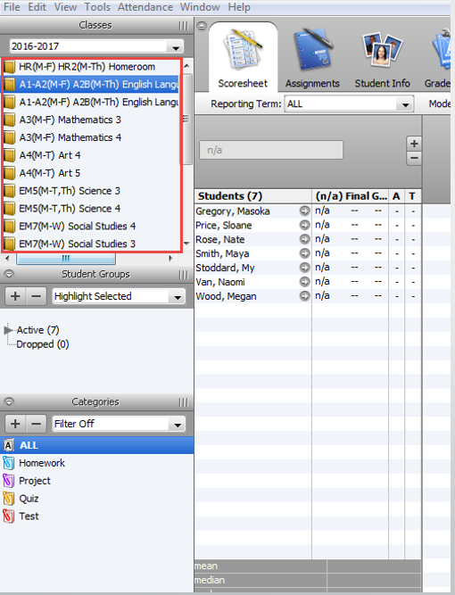
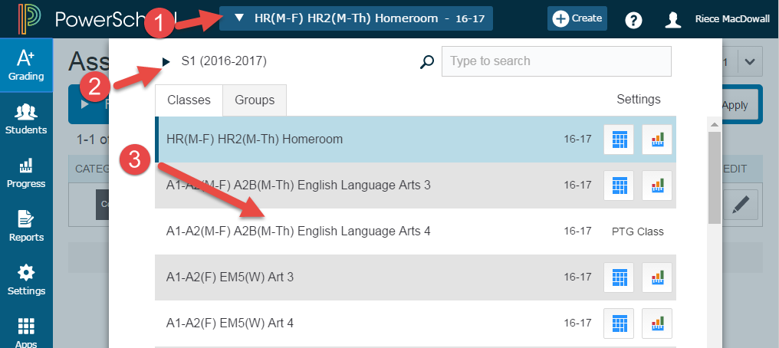
Accessing your Classes
In PT Gradebook you saw them in the upper left of your screen
In PowerTeacher Pro assessing your classes is as easy as 1,2, 3
Click on the classes drop down menu
Select the appropriate term and year
Select the class

Slide 7
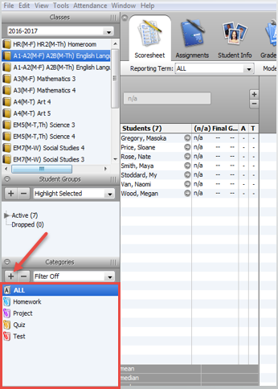
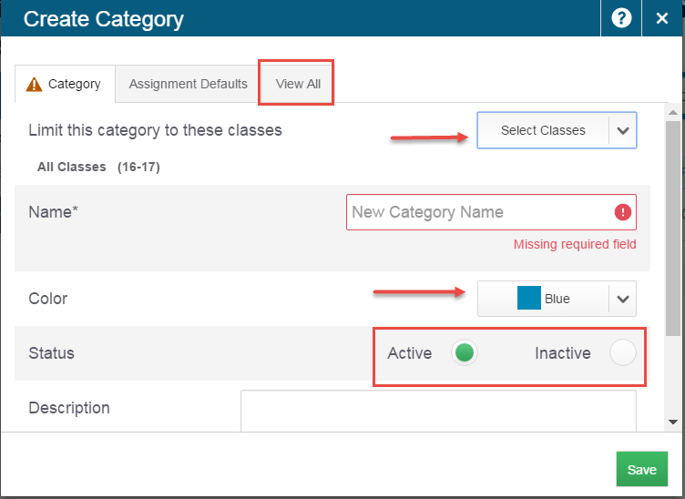
Accessing and Creating Categories
In PowerTeacher Pro creating or accessing your categories is as simple as clicking on the “+Create” button in the upper right and then clicking on Category.
In Gradebook you accessed categories by clicking on them in the lower left. You also created new categories by clicking on the “+” button.
From here you can create new categories as needed or see all your categories by clicking “VIEW ALL”. A NEW feature in PowerTeacher Pro is that you can now make inactive categories you no longer need, eliminating the long list of categories you may have once had.

Slide 8
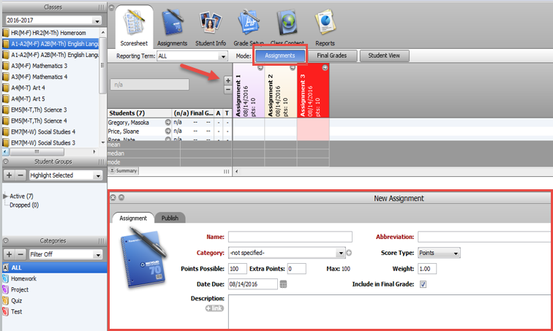
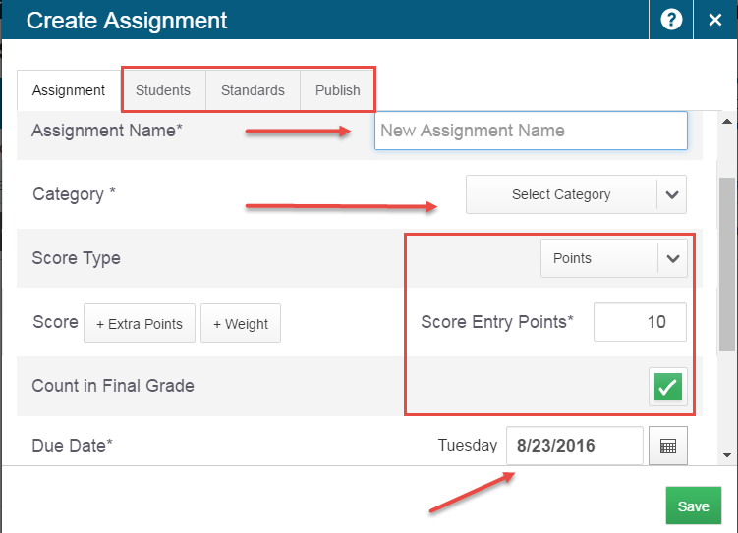
Creating New Assignments
In Gradebook you choose the Assignments tab and then clicked on the “+” button and created the new assignment with the data you required filling in the Name, Category, Points as required and added standards and outcomes as necessary (K-8 teachers)
In PowerTeacher Pro to create an assignment click on the “+Create” button in the upper right and select Assignment
Fill in the necessary data including the Name, Category, Score Type and Value, Count in Final Grade and You can still add Standards GCOs and SCOs
NEW FEATURE You can create assignments and assign them to specific students or groups of students by clicking on the “Students” Tab. You can also assign to multiple classes without needing to copy.

Slide 9
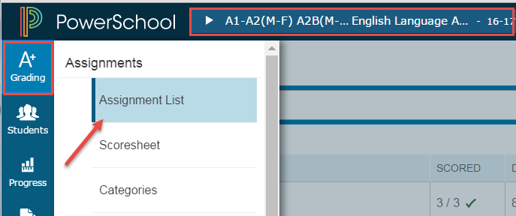
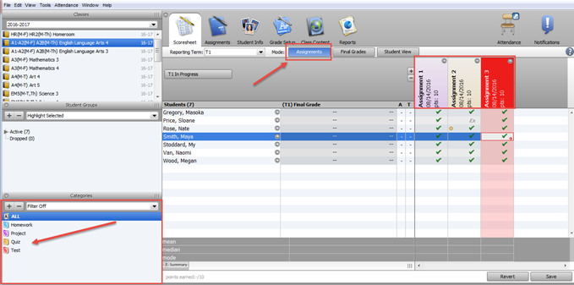
Viewing Assignments
In Gradebook you clicked on the “Assignments” tab to view them. Each assignment was color coded to match its category. You could filter categories by clicking on the category in the lower left and clicking Filter Selected.
In PowerTeacher Pro with the course selected, click on the “A+” grading menu on the left and select “Assignment List”.
You will see your entire list as indicated below. You can also filter a certain category be selecting the appropriate filter and clicking “Apply”.
The main assignment page will show you the assignment name, the number of students in the class and how many assignments you have put scores in for the due date and the sore type. You can edit any assignment by clicking on the Edit symbol.

Slide 10
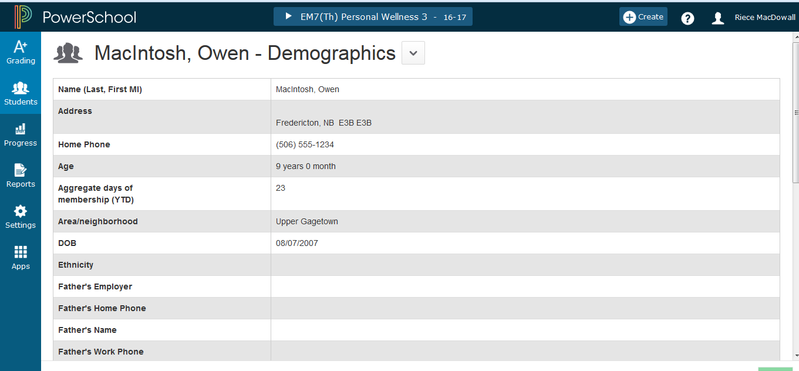
Viewing Student Information
In Gradebook you could view Student Information by clicking on the “Student Info” tab. You also had the ability to move columns around and create new custom columns but you could not remove any of the columns entered in from the office.
In PowerTeacher Pro click on the “Students” menu from the left hand side and select “Demographics”. You will be taken to the student demographic screen. This is a visual only screen of student data. You can select other students in the class by clicking the “down arrow” by Demographics and selecting another student. NOTE: You can create a more enhanced student information document through the “Reports” menu.

Slide 11
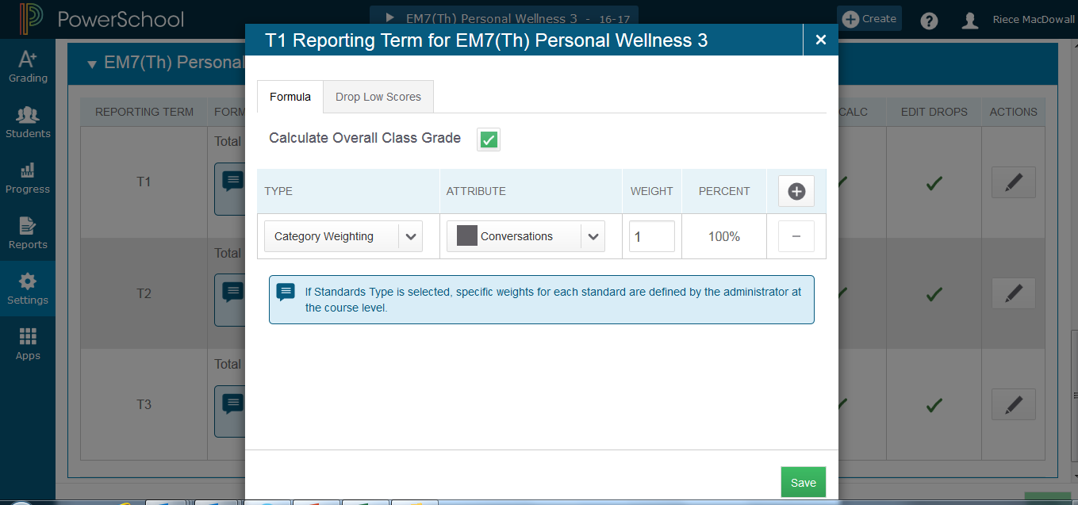
Grade Set Up (grades 9-12 only)
In Gradebook you clicked on Grade Setup and then clicked on calculations. Then you clicked on the appropriate term and set up the grading scale as determined at the school level.
In PowerTeacher Pro to set grade calculations click on “Settings” from the left menu bar and then click on “Traditional Grade Calculations”. From here you will select the appropriate term and then create the grading scale as determined at the school. NOTE: If using category weighting you will need to alter the WEIGHT once all categories are entered in order to get to the proper weighting you require for each category.

Slide 12
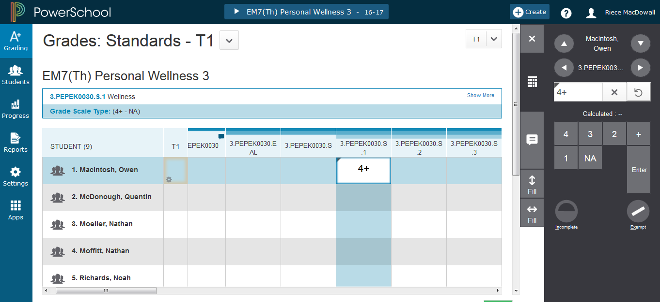
Final Grade Entry (K-8 only)
In PowerTeacher Pro to enter final grades in a particular reporting term click on “A+ Grading” menu on the left and select Standards under the Grades menu. Choose the appropriate term from the drop down menu in the upper right of the grading window. When you click on the appropriate standard a “key pad” will appear on the right. Fill scores using the keypad in the appropriate standard.
In Gradebook final grades were entered by clicking on he “Final Grades” tab and entering comments and standards indicators in the appropriate columns.
PLEASE NOTE: You will see the name of the standard in the viewing window just above the column you have selected. There is also an auto fill vertical and horizontal as needed to make data entry easier.

Slide 13
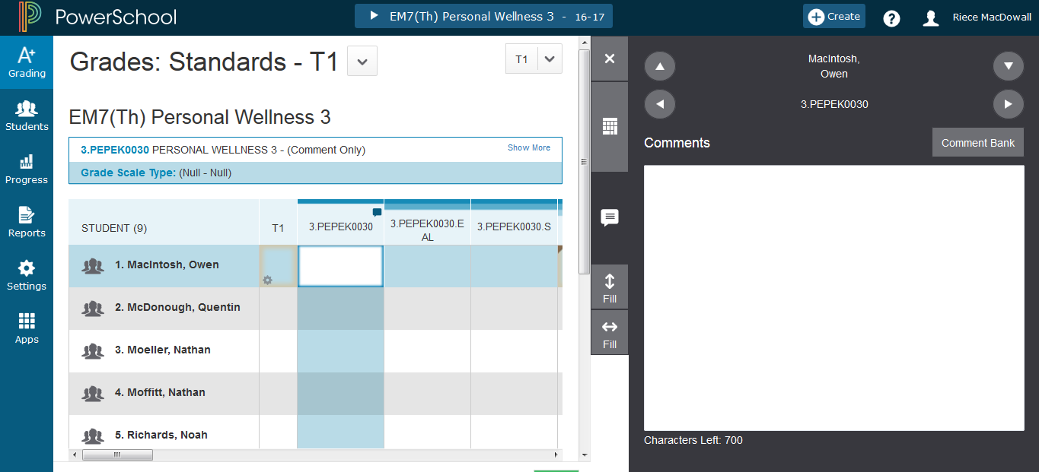
Final Grade Comment Entry (K-8 Only)
In Gradebook comments were entered by clicking on the “comment” column and entering comments as required for each subject. The comments were limited to 700 characters and 350 characters depending on the subject taught. There was a countdown character count at the bottom. There was also the option of using
In PowerTeacher Pro comments are entered by clicking on the “A+ Grading” menu from the left and selecting “Standards” under the Grades menu. You will notice the comment column by the small caption indicator in the upper right of the column. Click on the box next to the first student. You will now see the comment box on the right. You can make the comment box larger by clicking on the white comment tab.
PLEASE NOTE: The same report card comments lengths apply and there is a countdown character count to help you.

Slide 14
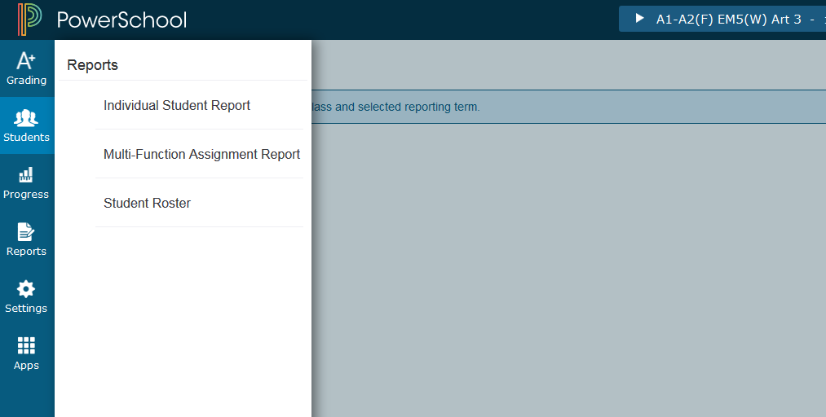
Reports
In Gradebook there were a variety of individual report that you could run. The reports gave you little flexibility in the data that was included on them.
In PowerTeacher Pro there are currently only three reports listed when you click on the “Reports” menu. However, each of these reports offers you greater flexibility in what columns you would like to include and offer exports as PDF and Excel for most reports. Making it possible to generate the similar reports to PTG with Custom Columns being added.

Slide 15
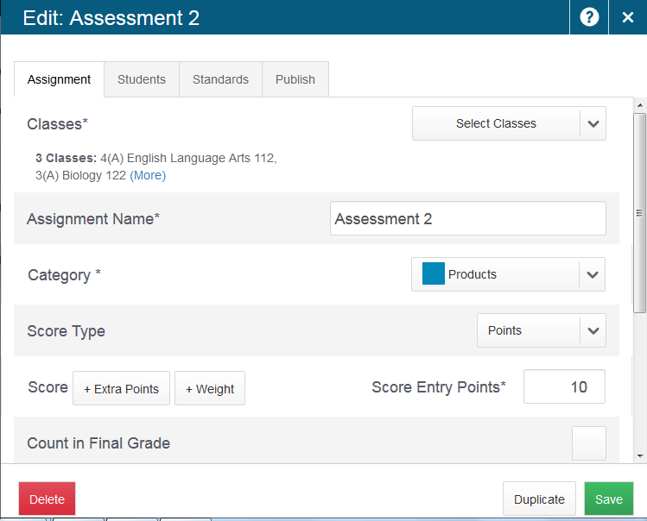
Copying of Assignments
In Gradebook assignments could be copied to any class in any year by selecting Tools from the Gradebook menu>Copy Assignments and then copying the desired assignment to any class.
In PowerTeacher Pro when an assignment is created it can be copied to any number of classes right from the main assignment menu by clicking on “Select Classes”.
As well there is the option to duplicate the assignment at any time to any other class by opening the edit assignment function and clicking on “Duplicate”

Slide 16
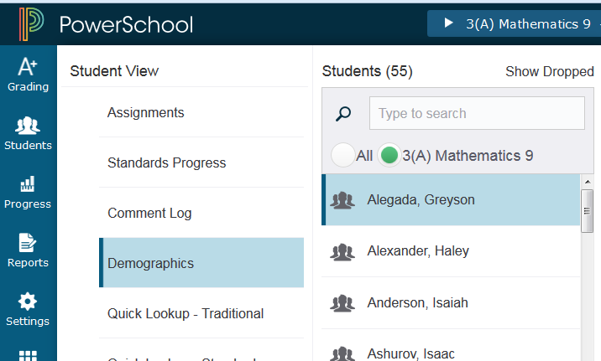
Student Demographics
In Gradebook you could see a student’s demographic information by clicking on the grey arrow beside their name.
In PowerTeacher Pro you can see a student’s demographic information by clicking on the “Students” menu and selecting any student and they clicking on the “Demographics” menu.

Slide 17
What to Learn More?
Check out the DataConnect Project Site http://dataconnect.nbed.nb.ca
There are PowerTeacher Pro Detailed Guides and a series of videos for both K-8 and 9-12 teachers

